Slide 1



TEAM NAME:
Anonymous

Slide 2
Problem Statement
Financial Product Recommendation Engine
Build a recommendation engine which studies patterns from the historical data and make predictions.

Slide 3
Use Cases & Business Value of the solution
Use Cases & Salient Features :
Automatic promotion of the products. (Sending Email’s to target Customers)
Product approval is approved based on user eligibility without any manual efforts.
Report generation for sales representative and Bank Management authorities and Analyst.
Chatbot integration Ex: (User: Can we approve the loan for XXXXX445 ,ML: Yes! With much Pleasure).
Business Value:
Using the traditional model with much improved enhancements which is hassle free and minimal interaction.
A single machine learning instance is only required to automate the process.

Slide 4
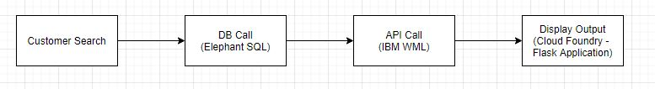
What was accomplished
Architecture
Products Recommended:
Personal Loan
Vehicle Loan
Credit Card
Housing Loan
Methods Used:
Jupyter Notebook (Personal Loan)
IBM Auto AI ( Vehicle Loan, Credit Card, Housing Loan)

Slide 5
What was accomplished
Jupyter Notebook – Steps
IBM instance Configuration and Connection establishment
Import Dataset
Preprocessing - Null Removal & Impute with Mode
Up sampling of Minority class to avoid Class imbalance
Train test split
ML Algorithm & Model development
Deployment of the Model

Slide 6
What was accomplished
Selection of Optimal ML Algorithms for Dataset
Based on the accuracy we went with Decision Tree for Personal Loan Model
Models Accuracy
Decision Tree 93.1
Random Forest 92.2
Gaussian NB 58.6
Bernoulli NB 56.77
Support Vector Machines (SVM) 79.03
Neural Networks (MLP) 57.88
Gradient Boosting 78.47
XGBoost 91.2

Slide 7
Describe your solution
Machine learning in finance may work magic, even though there is no magic behind it (well, maybe just a little bit). Still, the success of machine learning project depends more on building efficient infrastructure, collecting suitable datasets, and applying the right algorithms. The proposed engine can predict the products recommended for a customer based on his historical data. The ease of UI/UX interaction aims in minimizing the user effort and the environment is user friendly with much minimal input from user.
Technology Stack used
IBM Watson Machine Learning Studio
Elephant SQL (PostGres as service)
Python Flask
HTML
JavaScript
Cloud Foundry

Slide 8
What was accomplished
Auto AI Model
Other 3 models were built using AUTO AI
Housing Loan XGBClassifierEstimatorwml
Credit Card XGBClassifierEstimatorwml
Vehicle Loan ExtraTreesClassifierEstimatorwml

Slide 9
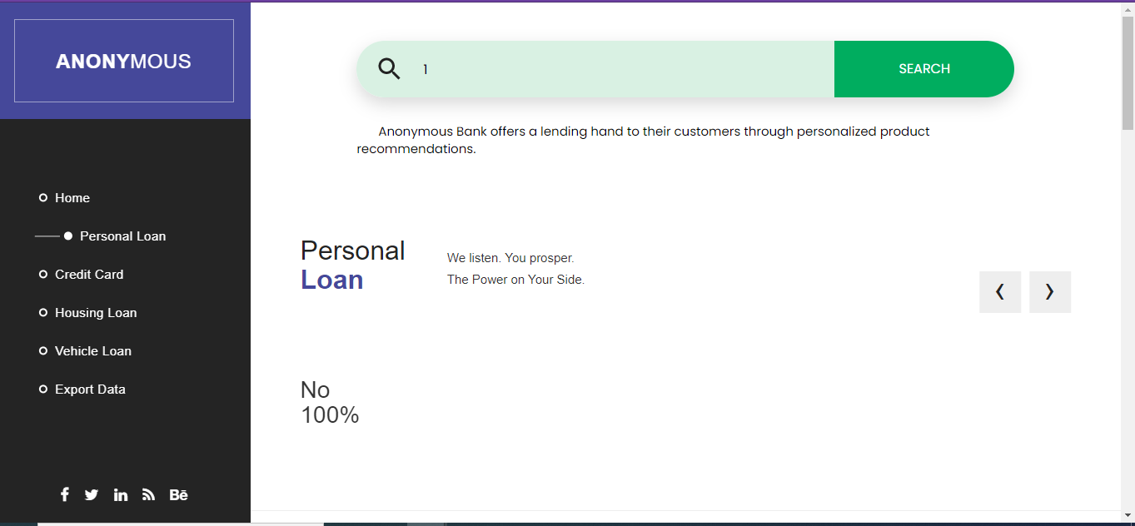
Screenshots (if any applicable)

Slide 10
Challenges & Learnings
Challenges :
Integration
Remote coordination
To find the right services and connecting to them via program
Learning:
Different Services of IBM cloud
Different Pricing Model of Services
Designing the pipeline and integrating them

